Slide 1
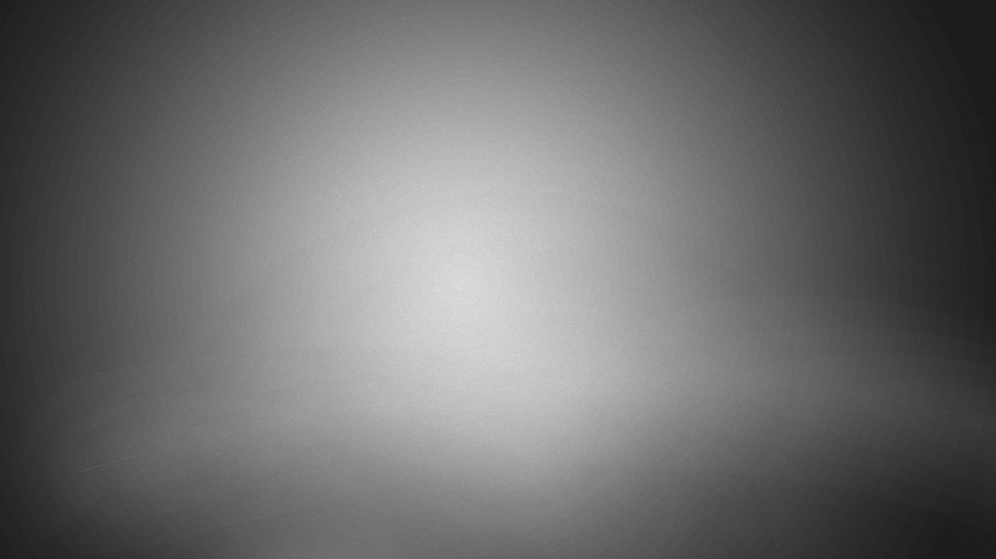
Image Deblurring using Modified Blind- Deconvolution
and comparisons between different deconvolution techniques

Slide 2
BATCH NO:17B Guide: B. Ravikiran
Y.VENKAIAH NAIDU 314126510118
R.NAVATEJA 314126510081
S.ARAVIND BABU 314126510088
R.SARAT KUMAR 314126510080

Slide 3
Abstract:
Observed images of a scene are usually degraded by blurring due to atmospheric turbulence and inappropriate camera settings. The images are further degraded by the various noises present in the environment and the system. Therefore it is essential to get a sharp clean image from the noisy blurred image. In digital imaging, blurring is a bandwidth reduction of the image due to imperfect image construction process which gives poor image quality. Some blurring always arises in the recording of a digital image. Along with these blurring effects, noise always corrupts any recorded image. Reconstructing process is divided into two categories, first is nonblind in which the blurring function is given and the degradation process is inverted using one of the restoration algorithms and second blind where blurring operator is not known. Deconvolution using blind method is very complex process where image recovery is performed with little or no prior knowledge of the degrading PSF. The PSF re present the impulse response of a point source . In this paper Blind Deconvolution method has been implemented to deblur a single image. SNR value is calculated for the image.

Slide 4
Goal of the project
The goal of the project is to deblur the blurred image using the blind deconvolution algorithm using PSF and SNR values of the images.
And to prove that blind deconvolution technique is the best when we are deblurring the image of which blur parameters are unknown.

Slide 5
Procedure:
At first the blurred is taken and it considered as the convoluted form.
We calculate SNR value of the initial blurred image.
We will perform blind deconvolution, Lucy-Richardson method, regularized filter, Wiener filter to the blurred image by estimating different PSF values.
For every PSF values we will generate a image and calculate its SNR value.
We will compare the SNR values of the generated images and the highest SNR value image is consider as output.

Slide 6
Deconvolution:
Deconvolution is to restore or reconstruct the image that has been degraded by convoluting with a known degrading function.
f
y
F’
convolution
Deconvolution
g
g

Slide 7
Cont…
Since we are using MATLAB , we have four Deconvolution functions. Based on your image blur ,you should select the respective deblurring method.
deconvblind-Deblur image using blind deconvolution
deconvlucy-Deblur image using Lucy-Richardson method
deconvreg-Deblur image using regularized filter
deconvwnr-Deblur image using Wiener filter

Slide 8
PSF:
For applying deconvolution technique we are creating PSF to a image(Point Spread Function) in matlab
fspecial Create predefined 2-D filters.
H = fspecial(TYPE) creates a two-dimensional filter H of the
specified type. Possible values for TYPE are:
'average' averaging filter
'disk' circular averaging filter

Slide 9
PSF:
'gaussian' Gaussian lowpass filter
'laplacian' filter approximating the 2-D Laplacian operator
'log' Laplacian of Gaussian filter
'motion' motion filter
'prewitt' Prewitt horizontal edge-emphasizing filter
'sobel' Sobel horizontal edge-emphasizing filter
'gaussian' Gaussian lowpass filter
'laplacian' filter approximating the 2-D Laplacian operator

Slide 10
PSF:
In all these types we are using motion filter H = fspecial('motion',LEN,THETA) returns a filter to approximate,
Once convolved with an image, the linear motion of a camera by LEN pixels,
with an angle of THETA degrees in a counter-clockwise direction. The
filter becomes a vector for horizontal and vertical motions. The
default LEN is 9, the default THETA is 0, which corresponds to a
horizontal motion of 9 pixels.

Slide 11
SNR:
Signal to Noise Ratio is calculated as the ratio of the mean pixel value to the standard deviation of the pixel values over a given neighbourhood. Sometimes SNR is defined as the square of the alternative definition above
SNR= mean pixel value / standard deviation of the pixel values .
SNR is measured in decibels (dB)

Slide 12
Architecture:
Blurred image
Applying deconvolution techniques
Calculating SNR of generated images
Retrving the highest SNR image
deblurred image

Slide 13
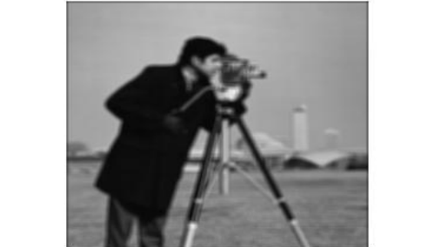
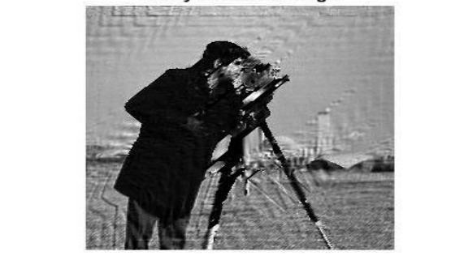
Expected Output:
Input:
output:

